Slide 1





Wireless Local Area Network
Submitted By:
Submitted To:
Tanvir Islam
ID: IT-21027
Session: 2020–2021
4th year,2nd semester
Dr. Md. Nazrul Islam
Associate Professor
Dept of ICT, MBSTU

Slide 2

1. Introduction
What is WLAN?
A Local Area Network without physical cables. Uses radio waves to transmit data. Covers a limited area — home, office, or campus. Devices can move freely while staying connected.

Slide 3



2. Historical Background
1970s
1997
1999
First experiments with wireless networking
IEEE introduced 802.11 standard
Wi-Fi Alliance formed to certify devices
2000s
2020+
WLAN became popular in homes & offices
Wi-Fi 6 and 6E offer multi-gigabit speeds

Slide 4
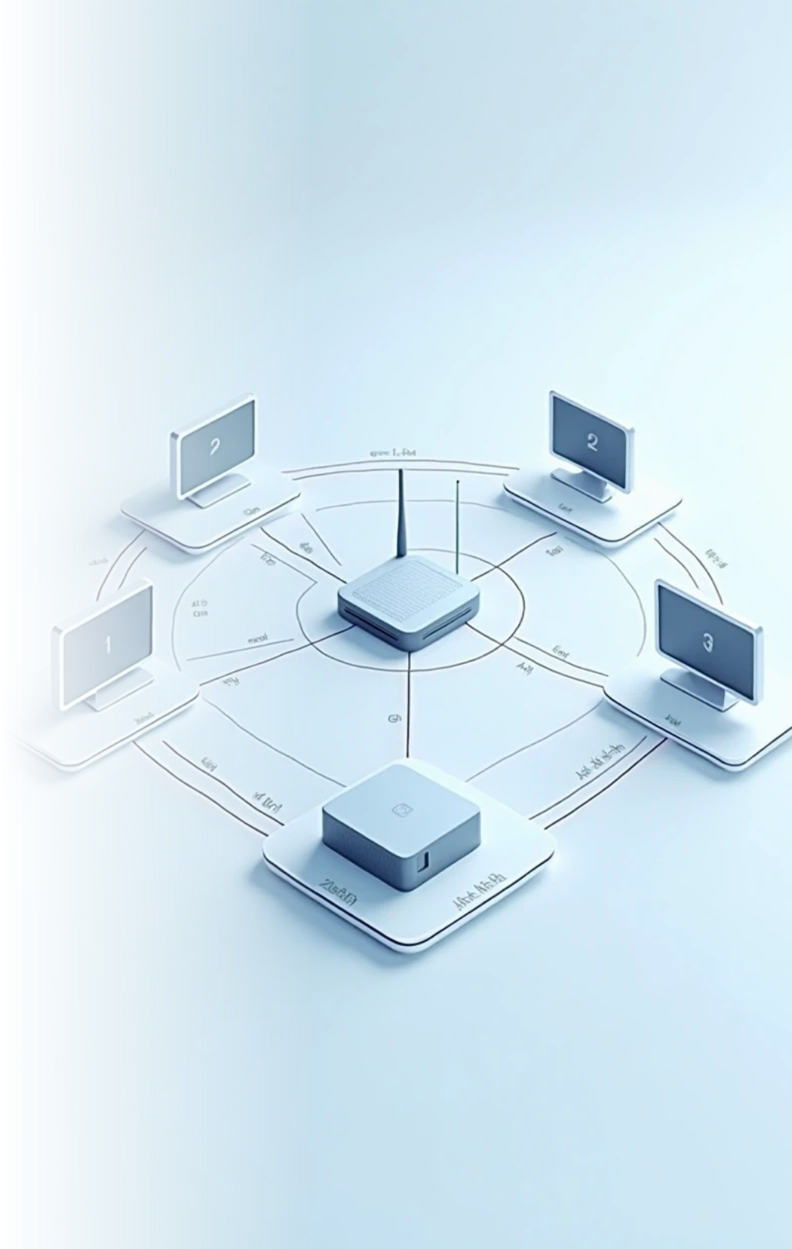




3. Working Principle of WLAN
1
2
Devices send and receive data via Access Point (AP)
Communication happens over radio frequencies (2.4 or 5 GHz)
3
4
Router connects WLAN to the Internet
Data packets are transmitted using protocols
Diagram: Router in center → devices connected wirelessly

Slide 5
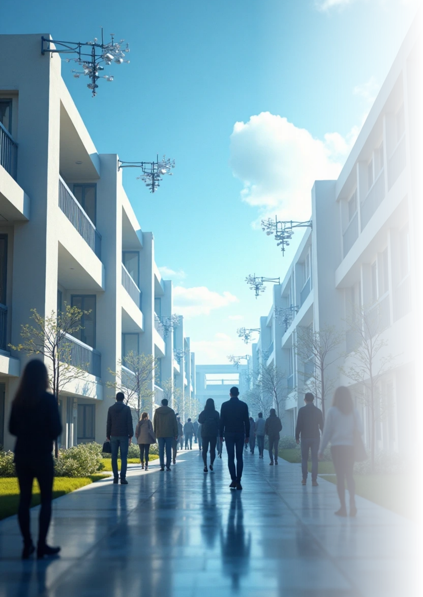


4. Architecture of WLAN
Basic Service Set (BSS)
Extended Service Set (ESS)
One AP and clients
Multiple APs connected
Distribution System (DS)
Stations (STA)
All wireless devices
Connects multiple BSS together

Slide 6



5. Components of WLAN
1
2
Access Point (AP) – creates wireless signal
Wireless Adapter – built into devices
3
4
Router – provides network connectivity
SSID – network name
5
Antenna – transmits and receives signals

Slide 7
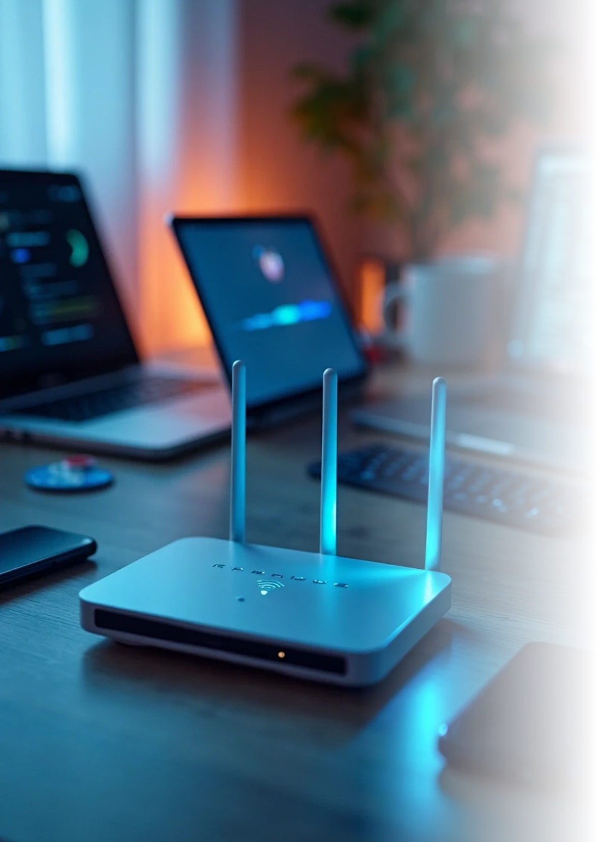

6. Types of WLAN Operation Modes
Infrastructure Mode
Devices connect via AP
Ad-hoc Mode
Devices connect directly (peer-to-peer)
Hybrid Mode
Combination of both

Slide 8
7. IEEE 802.11 Standards
Standard | Frequency | Max Speed | Introduced | Common Name
802.11a | 5 GHz | 54 Mbps | 1999 | Wi-Fi 1
802.11b | 2.4 GHz | 11 Mbps | 1999 | Wi-Fi 2
802.11g | 2.4 GHz | 54 Mbps | 2003 | Wi-Fi 3
802.11n | Dual Band | 600 Mbps | 2009 | Wi-Fi 4
802.11ac | 5 GHz | 1 Gbps | 2013 | Wi-Fi 5
802.11ax | Dual Band | 10 Gbps | 2019 | Wi-Fi 6

Slide 9


8. Advantages of WLAN
No physical cables
Easy to install & expand
Portable and flexible
Supports mobility
Multiple devices at once

Slide 10


9. Disadvantages & Security Issues
1
Limited range
2
Slower than wired LAN
3
Signal interference (microwave, Bluetooth)
4
Security risks — hacking, data theft

Slide 11


Disadvantages of WLAN
Extra Part: WLAN Security Methods
WEP, WPA, WPA2, WPA3 encryption
Firewalls and MAC address filtering

Slide 12




10. Applications of WLAN
Campus Networks
1
Home Wi-Fi & Smart Homes
2
Hospitals & Airports
Business Organizations
3
4
IoT & Industrial Automation
5

Slide 13
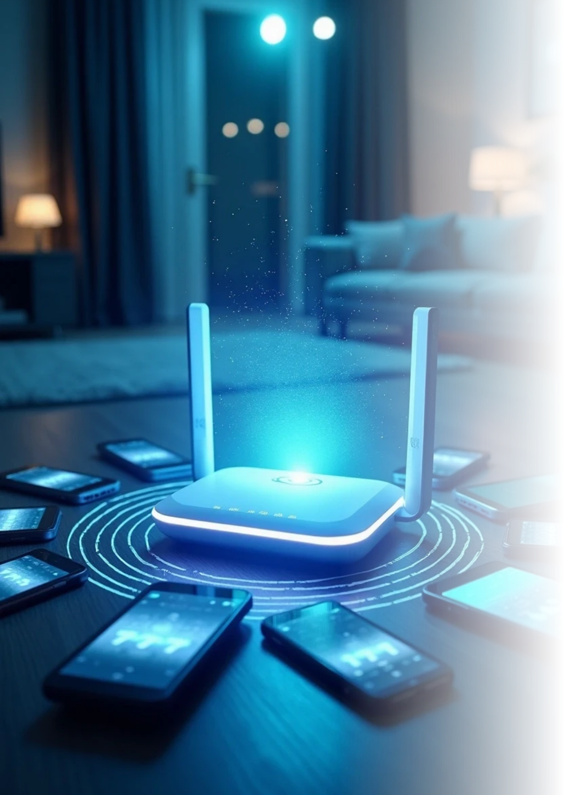


11. Future Developments in WLAN
Wi-Fi 7 (802.11be) – ultra-high speed
Integration with 5G networks
IoT connectivity for billions of devices
Improved AI-based signal optimization
Energy-efficient WLAN systems

Slide 14





12. Conclusion
1
2
WLAN revolutionized local networking
Enables seamless, wireless communication
3
4
Balances mobility, cost, and performance
Plays a key role in smart technology

Slide 15

Thank You

